Slide 1

Sales Dashboard – Task 4
Data Analyst Internship

Slide 2
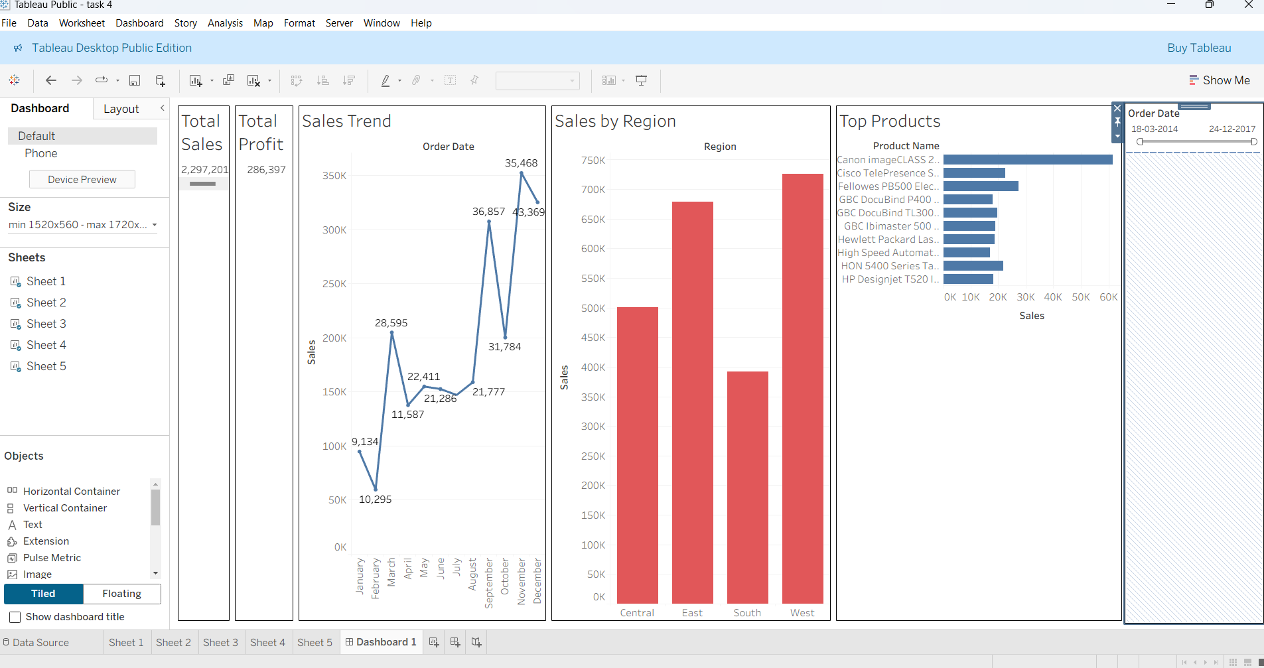
Dashboard Screenshot
The dashboard shows key business KPIs with interactivity filters based on time, category, and region.

Slide 3
KPIs Used in the Dashboard
Total Sales
Total Profit
Sales Trend Over Time
Top 10 Product by Sales
Sales by Region
Filters: Region, Category, Order Date

Slide 4
Insights and Business Decisions:
Identify high-performing and underperforming region
Track profit margins over time
Find top-selling products to focus marketing efforts
Monitor sales trends to forecast demand
Use filters to explore data for specific months or categories

